Slide 1

Fundamentals of Energy Efficient Building Operations
Month Day, Year
Instructor Name, Position
Instructor Company
Phone
Name@email.com
Notes:
Fundamentals of Energy Efficient
Building Operations
Edition 3.00
Instructor’s name: __________________________________________________________
Phone number: ____________________________________________________________
E-mail: ___________________________________________________________________
_________________________________________________________________________
_________________________________________________________________________
_________________________________________________________________________
_________________________________________________________________________

Slide 2
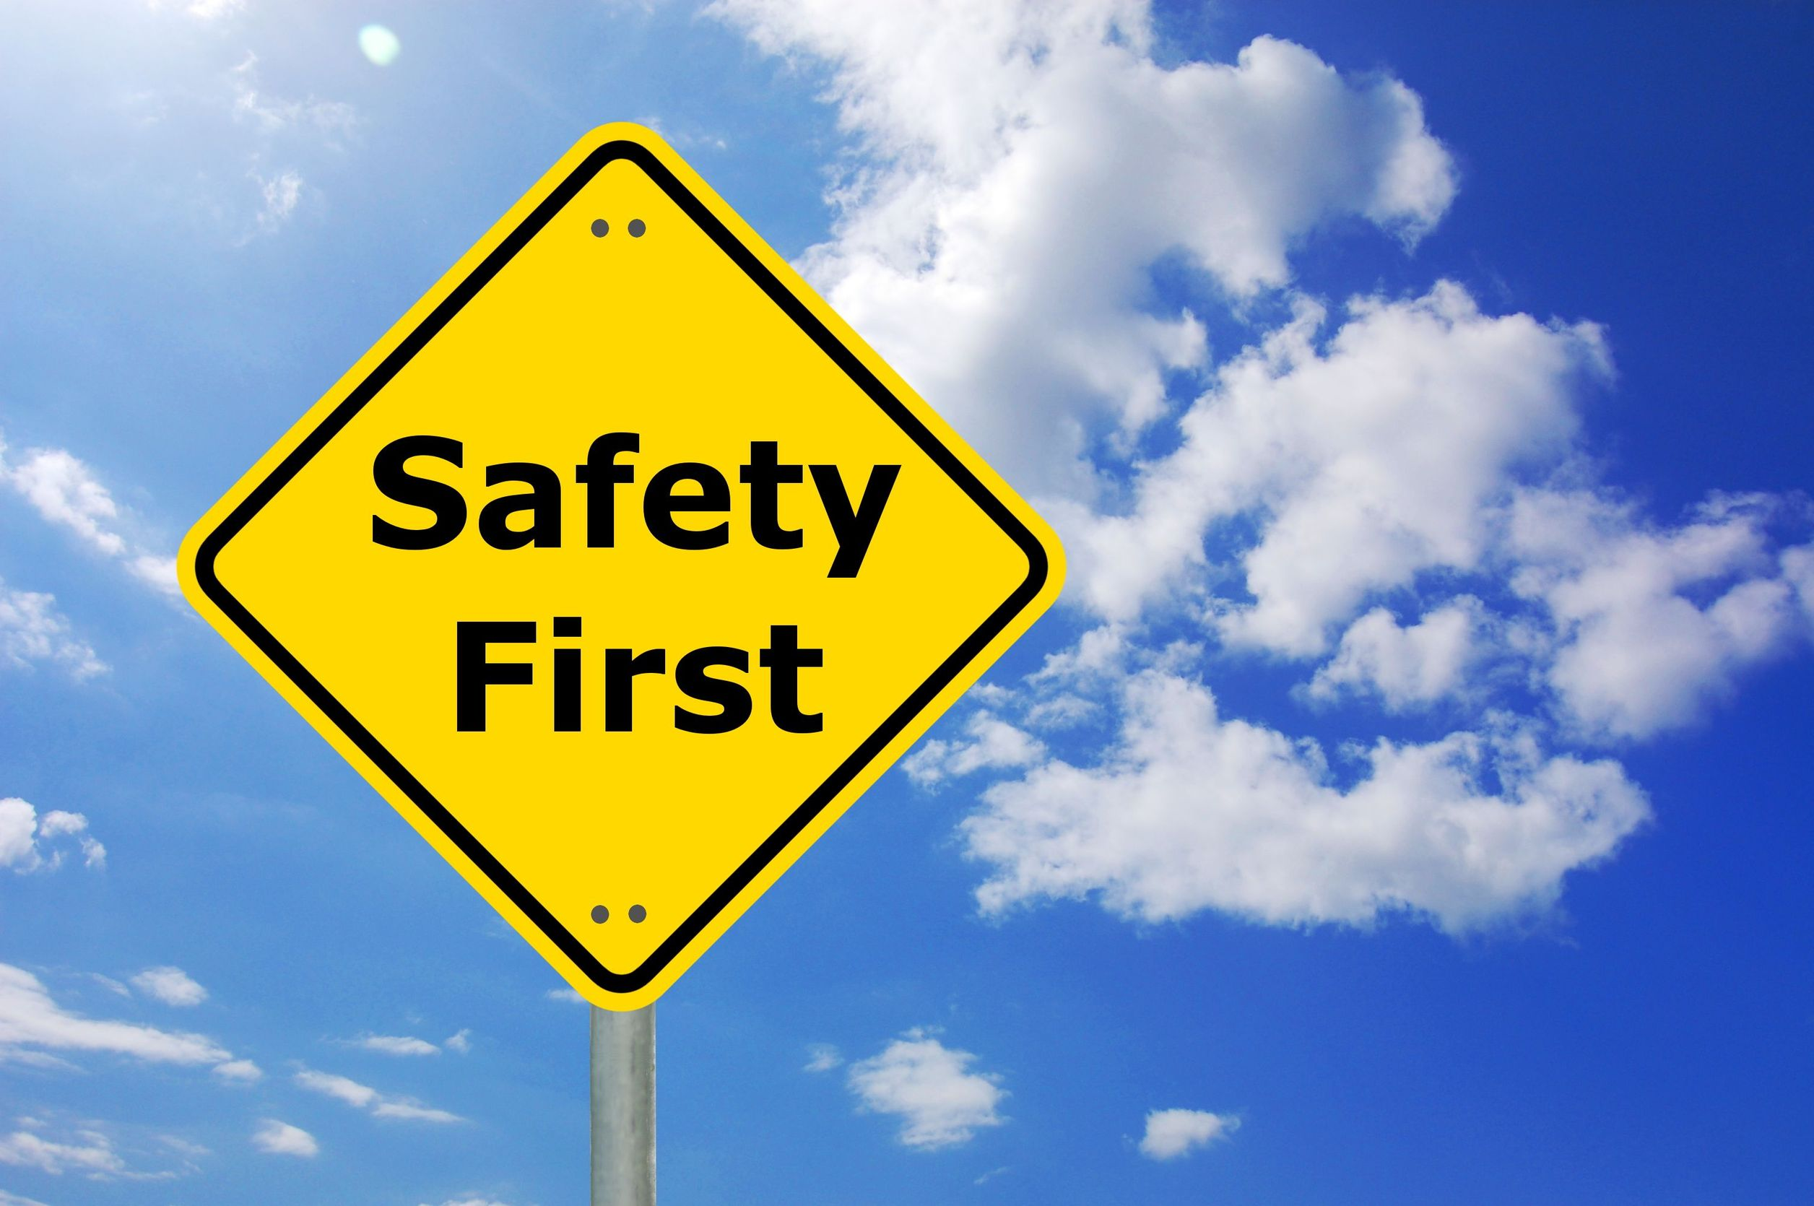
Safety Message
Notes:
Let's start with a safety reminder. This may be something from the course sponsor or site host; the instructor, moderator, or a student. Topics can include anything related to safety: site, health, personal, equipment, etc. What topic shall we address today?

Slide 3
Training Goals
Goal
Increase awareness of energy efficiency concepts and develop core principles of energy efficient practices in commercial buildings
Learning objectives
Achieve general awareness of facilities and instill efficiency ethic
Strengthen building operation optimization skills
Identify areas for energy savings
Make energy-smart decisions in day-to-day tasks
Notes:
The implementation of building optimization and energy efficiency principles in your portfolio can help the organization meet its energy and financial goals.
Everyone working in facilities plays a significant role in achieving the organization’s goals and saving energy.

Slide 4

What is in it for me?
Our interactive training session will allow you to:
Recognize the impact of existing buildings on the environment
Recognize YOUR impact on your facilities
Evaluate and prioritize energy initiatives in your facilities
Develop a plan for your facilities and measure your success
Get Everyone Rowing In The Same Direction
Notes:
Implementation of building optimization and energy efficiency principles not only helps meet your organization’s energy targets, but can also improve the work that you do in ways such as:
Attaining a more intimate knowledge of your facility/facilities
Discovering areas for improvement not previously known
Enabling continued monitoring and tracking of performance and success

Slide 5
Curriculum
Part 1: Energy Efficiency and Sustainability Overview
Part 2: HVAC Fundamentals
Part 3: Lighting Fundamentals
Part 4: Energy Management
Part 5: Energy Conservation Opportunities
Part 6: Indoor Environmental Quality
Part 7: Putting It All Together

Slide 6
Fundamentals of Energy Efficient Building Operations
Part 1: Energy Efficiency and Sustainability Overview

Slide 7
Part 1 Agenda
A. Program Overview
B. Concepts of green and high-performance buildings
Trends in building operations
Building a plan for your facilities
Learning activity: Developing Your Facility’s Baseline and Goals
Green building certification

Slide 8
BOC Operator Credentials
Verify your experience and knowledge to do an effective job
Demonstrate commitment to professionalism
Enhance job opportunities
Help increase job safety
Help improve job productivity and building performance
Notes:
Whether formal or informal, operator training has historically placed little emphasis on energy-efficient building practices. Nor was there, until recently, an understanding of the important role technicians play in improving and maintaining building energy performance.
According to a study by the Washington State Energy Office, trained and motivated building technicians can reduce utility costs at facilities by at least 5 to 15 percent. Today, the role of the operator in impacting energy savings and costs is well established through an ample body of evaluation research.
One of the key jobs to ensure energy efficiency in buildings is through building maintenance and operations. As noted in BOMA Magazine, “In order to be successful in a sustainable world, the operating engineer must not only have extremely high technical skills, but must also know how to operate buildings efficiently.” This requires in-depth training from an established program that has proven success.

Slide 9
Credential Options
BOC offers four credentials: three certificates and one certification
Each credential has a designation:
Fundamentals of Energy Efficient Building Operations Certificate
BOC Level I Training Certificate of Completion
BOC Level II Training Certificate of Completion
Certified Building Operator
Notes:
The BOC program offers four professional credentials that demonstrate that you have acquired specific knowledge, skills, and/or competencies that can be used on the job.
Three credentials are training certificates which recognize those operators who have successfully completed the Fundamentals of Energy Efficient Building Operations course, or a BOC Level I or II course series. Certificates provide a valuable credential for operators interested in demonstrating completion of required study and project work to enhance knowledge and skills in building operations.
The fourth credential recognizes operators who have successfully passed the BOC Certification Examination. These individuals may use the designation Certified Building Operator (CBO). A CBO certification provides assurance to employers that operators have mastered the knowledge gained from work experience, study, and passing a comprehensive national exam. After earning your BOC Level I Certificate, you are eligible to sit for the certification exam.

Slide 10
The Coursework
Fundamentals: One comprehensive test given at the end of the course. No project assignments.
Level I: Building Systems Maintenance
Level II: Improving Operational Performance
Tests - Taken at end of each class day
Project - Five project assignments completed at your facility
Notes:
Building Operator Certification training is offered in three courses. Each course requires completing a set of classroom training including participatory learning activities. The Fundamentals course includes a comprehensive test given at the end of the course, covering material given in each class. Level I and Level II includes tests at the end of each class within the course, as well as applied learning project assignments outside of class. After completing the Level I training, a student is eligible to apply for certification. Your BOC program administrator will provide more information about this process.
Fundamentals of Energy Efficient Building Operations
Seven classes focusing on basic principles of energy efficiency awareness and practices in commercial buildings.
Level I
Seven classes focusing on major building systems and best practices for their operation and maintenance.
Level II
Six classes presented focusing on evaluating the operational performance of a building, with a focus on building scoping to identify opportunities for operational improvement.

Slide 11
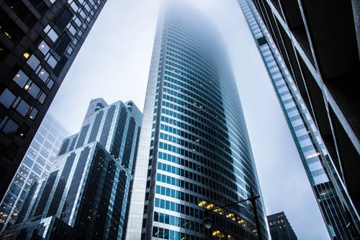
Why are existing buildings important?
5.6 million commercial buildings in the U.S.
These Buildings Generate:
  35-45% of municipal solid waste
  18% of total CO₂ emissions
These Buildings Consume:
  18% of all energy used in U.S.
  35% of all electricity
  17% of all potable water
Notes:
In addition to electricity, it is important to consider the impact of our commercial buildings on other resources such as natural gas, water, and waste, as well as the consequences of greenhouse gas (GHG) emissions.
Building re-tuning concerns energy specifically, but can lay the foundation for looking at other resources and ways to conserve them.
Sources:
Waste: https://www.epa.gov/facts-and-figures-about-materials-waste-and-recycling/national-overview-facts-and-figures-materials
CO2: https://www.eia.gov/environment/emissions/ghg_report/pdf/tbl7.pdf
Energy: https://www.eia.gov/consumption/
Electricity: https://www.energy.gov/eere/buildings/about-commercial-buildings-integration-program
Water: https://sftool.gov/learn/about/183/buildings-water
Image source: pexels.com

Slide 12
Buildings’ Share of U.S. Primary Energy Consumption
Source: U.S. Energy Information Administration (EIA), 2021
Notes:
Introduction
Commercial and residential buildings combined use about 40% of total energy produced, higher than any other sector in the United States. These buildings consume 72% of electricity and 55% of natural gas, at a cost of $202.3 billion annually. The energy used inefficiently or unnecessarily is estimated to be as much as 30%, with buildings accounting for 38% of the carbon dioxide emissions in the country.

Slide 13
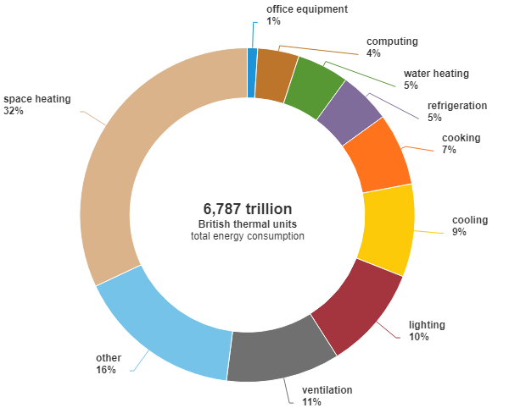
Commercial Sector Buildings Energy End Use
Major fuels consumption by end use in U.S. commercial buildings, 2018 (share of total)
Notes:
HVAC and lighting account for 62% of a building’s energy use. There are many opportunities for optimizing HVAC and lighting systems and minimizing their energy losses.
Addressing inefficiencies in the operation and maintenance of building systems is a proven approach to achieving energy savings in commercial buildings.
Seasoned building technicians familiar with building automation systems, common building mechanical system types and equipment, and HVAC control sequences are better prepared to identify frequent problems and solutions that afford the greatest energy benefits: equipment scheduling, sensor error, simultaneous heating and cooling, and outside air usage.
The implementation of these low-cost and no-cost operating adjustments is well established as a means for generating energy savings in the range of 5-20 percent.
Source: https://www.eia.gov/energyexplained/use-of-energy/commercial-buildings.php
Data source: U.S. Energy Information Administration, 2018 Commercial Buildings Consumption Survey, December 2022

Slide 14
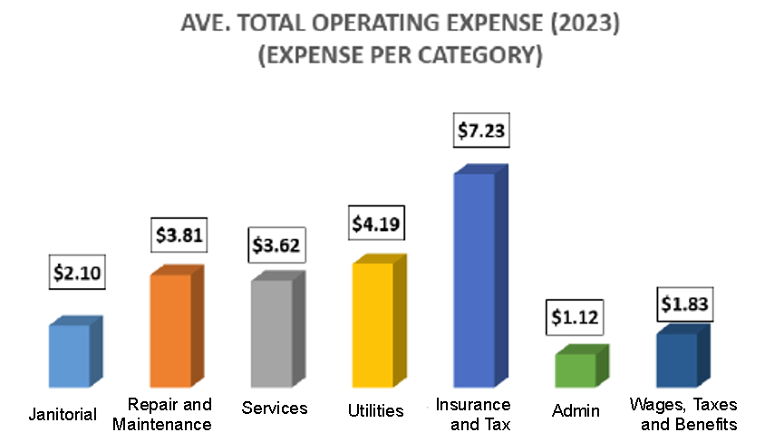
Building Energy Costs
Source: BOMA International, 2024 Benchmark Report
Notes:
Energy costs appear in the ‘utilities’ category in the chart above. Utilities costs comprise the single greatest cost category after “Insurance and Tax”.
Most U.S. buildings’ expenses break down into a similar distribution — largely fixed costs, followed by utility bills, repairs and maintenance expenses (R/M). On average, building owners spend 22% of their operating costs on energy and water. Corporate facilities typically spend slightly more on utilities, while general multi-tenant buildings spend less. Many operators, when assessing only the value of energy bill reductions, will choose not to invest in energy retrofits.
Source: https://www.bomaonthefrontline.com/2024/07/26/2024-operating-benchmark-report-is-now-available/

Slide 15
Sustainability:
Balancing the demands of economic development, environmental protection, and community equity
Meeting the needs of the present without compromising the ability of future generations to meet their needs
Future
Present
Notes:
We’ve discussed how commercial buildings use energy and the cost of energy for utilities. Now let’s talk about the concept of sustainable buildings.
What is the definition of sustainability?
Sustainability is a globally defined issue and is well recognized around the world.
Sustainability refers to how we treat the environment and our resources, while balancing the needs of the present with the needs of future generations.
Operating a building efficiently addresses sustainability while helping extend the service life of our facilities and can be accomplished by those people who build and operate the facilities with a long-term view.
Source:
https://www.epa.gov/sustainability/learn-about-sustainability

Slide 16
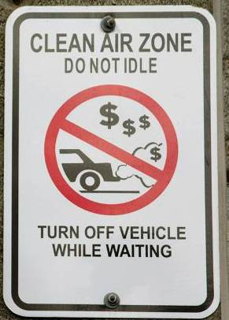


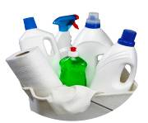
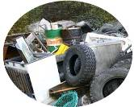
Key Targets:
Why is sustainability important?
Energy Use
Water Use
Indoor Environment
Waste Production
Material Use
Notes:
A sustainable facility is concerned with:
Decreasing energy, water, and material use
Increasing indoor environmental quality (IEQ)
Minimizing waste production
The BOC and this training session focuses on two of these: energy use and IEQ. IEQ consists of qualities that make a building a comfortable and productive place for its occupants, including indoor air quality (IAQ) and lighting and noise levels.

Slide 17
Triple Bottom Line
Social
Balance
Environmental
Financial
Notes:
We’ve discussed the concept of sustainable buildings. A related concept is the triple bottom line which is one we often see cited in corporate sustainability plans. The triple bottom line seeks to refine the typical financial bottom line and encourages considering all three aspects as decisions are made.
Social – focus on people and occupant satisfaction, comfort and productivity
Environmental – focus on environmental concerns such as climate impacts, resource management, and reducing harm to the environment
Financial – focus on profits, return on investment, and financial impacts

Slide 18
Group Discussion
Think about the overall sustainability of your own company or organization.
What are the advantages and obstacles to making your building operations more sustainable?
Notes:
List two or more advantages of making your building operations more sustainable:
____________________________________________________
____________________________________________________
____________________________________________________
List two or more barriers to making your building operations more sustainable:
____________________________________________________
____________________________________________________
____________________________________________________

Slide 19
Energy Use and the Indoor Environment
Energy Use
Comfort
Health
Indoor Environment
Notes:
Often, we try to save energy in an effort to reduce costs, but the way energy is used also plays a role in the indoor environmental quality (IEQ) of a building, affecting the health and comfort of its occupants.
Take the example of HVAC: Too much or too little heating, cooling, and ventilating a building can potentially make an occupant uncomfortable or unwell.
Finding the “sweet spot” between conserving energy and preserving IEQ is key to both energy use and occupant productivity.

Slide 20
What Affects Occupants?
Health affected by:
Comfort affected by:
Indoor air contaminants
Volatile organic compounds (VOC)
Particulate matter (PM)
Sick building syndrome
High carbon dioxide (CO2) level
Temperature/relative humidity
Lighting levels
Excessive noise
Notes:
IEQ aspects that affect health and comfort from a facilities perspective are shown above.
Notice that the indoor environment deals with more than just indoor air quality. Lighting levels affect comfort and productivity as well.

Slide 21
Connection to Energy Use
Health Improved by
Comfort improved by
Ventilation
Ventilation
HVAC adjustments
  Thermostat setting
  Scheduling
Lighting adjustments
Notes:
The most effective way to remove air contaminants is through ventilation. Ventilation can be provided passively, or naturally, by opening windows, or mechanically by exhausting indoor air to the outside and bringing in fresh outdoor air.
Temperature, humidity and lighting levels may need to be adjusted up or down to achieve optimal comfort and productivity. The benefits of improved comfort will need to be weighed against energy use if energy use increases as a result of the adjustments.

Slide 22
Balancing Priorities
Occupancy Comfort & Productivity
Balance
Operations & Maintenance
Security Considerations
Notes:
As a building operator, we often have competing priorities and we should strive for a balance in these priorities.

Slide 23
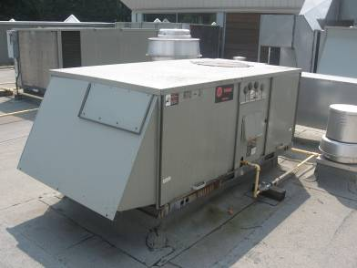
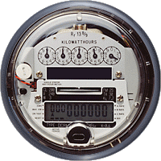
Outside Air and Energy Impact
Providing more outside air than required wastes energy
Balance the Indoor Air Quality (IAQ) benefit of more outside air with the increased energy use
Notes:
More outside air increases the amount of air needed to heat and cool the space which increases energy consumption and costs. Again, added ventilation will have to be evaluated for value against occupant comfort and productivity.

Slide 24
IEQ Discussion
Think about a commercial building in which you work or spend a lot of your time in. Which indoor environmental qualities do you think the occupants care most about?
What aspects of IEQ can building operators address in their role and daily responsibilities?
Notes:
Think about a commercial building you work in or spend a lot of your time in. Which qualities of IEQ do you think the occupants care most about? Choose up to three of the options below:
Air quality
Comfort
Visual and light quality
Acoustics
Navigation in the building
Water quality
What aspects of indoor environmental quality can building operators help address in their role and daily responsibilities?
_________________________________________________________________________

Slide 25
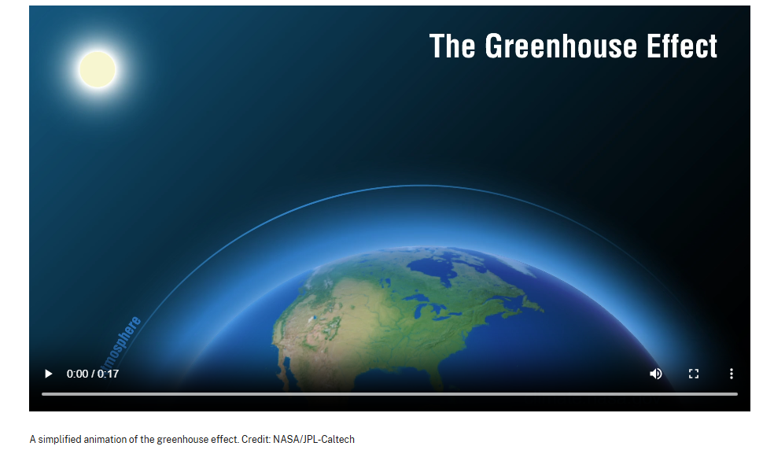
What is the Greenhouse Effect?
Watch this short video from NASA:
https://science.nasa.gov/wp-content/uploads/2014/09/126-greenhouse-effect-revised-hd-english.m4v
Notes:
The greenhouse effect is the process through which heat is trapped near Earth's surface by substances known as 'greenhouse gases.' Imagine these gases as a cozy blanket enveloping our planet, helping to maintain a warmer temperature than it would have otherwise. Greenhouse gases consist of carbon dioxide, methane, ozone, nitrous oxide, chlorofluorocarbons, and water vapor. Water vapor, which reacts to temperature changes, is referred to as a 'feedback', because it amplifies the effect of forces that initially caused the warming.
Video link: https://science.nasa.gov/wp-content/uploads/2014/09/126-greenhouse-effect-revised-hd-english.m4v
Without the natural greenhouse effect, the earth would be too cold for most life to survive. However, because of the human activity of burning fossil fuels, a much higher than normal concentration of greenhouse gases is released into the atmosphere.
Where Excess Greenhouse Gases Come From
According to the U.S. Environmental Protection Agency, some of the economic activities that most contribute to the production of greenhouse gases are transportation, electricity production, industry, and agriculture. Also, most of these greenhouse gas emissions are in the form of carbon dioxide, followed by lesser amounts of methane, nitrous oxide, and fluorinated gases.
Why Greenhouse Gases Matter
Climate change is a natural phenomenon, but the greenhouse gases produced by human activity may drive global warming in an unnatural way. Through activities like raising livestock, driving cars, using energy, and managing waste poorly, human activity can produce greenhouse gases that may promote global warming.

Slide 26
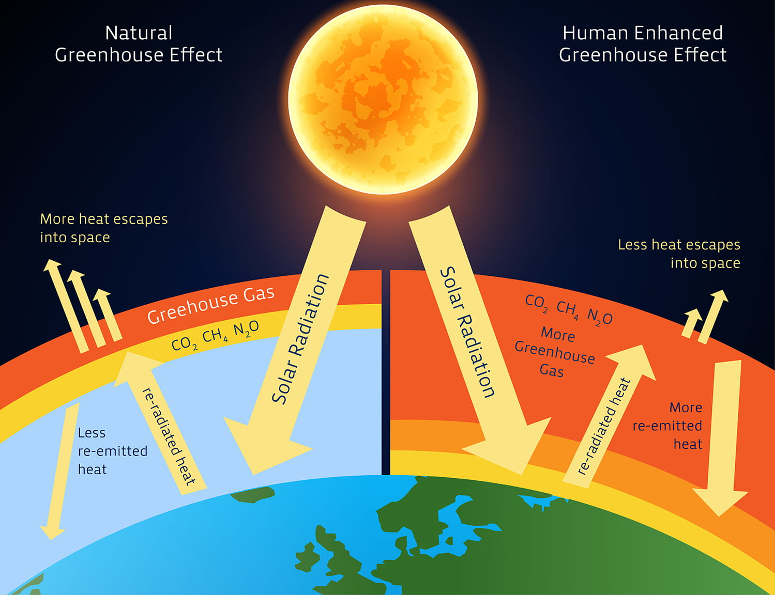
What is the Greenhouse Effect?
Notes:
This image is another way to illustrate the Greenhouse Effect. It depicts the natural cycle of the sun’s energy as it is absorbed by the earth and released back into space. The build up of greenhouse gases in the atmosphere interrupts the natural cycle by trapping heat from being released into space.
Image source: https://www.science.smith.edu/climatelit/greenhouse-effect/

Slide 27
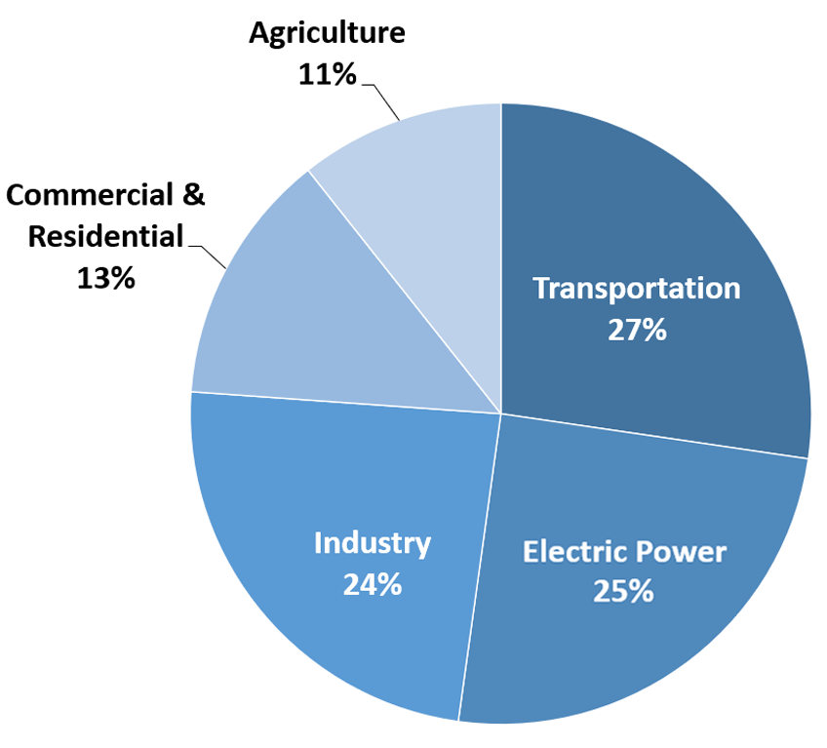
Where do GHG Emissions come from?
Sources of U.S. Greenhouse Gas Emissions in 2020
U.S. Environmental Protection Agency (2022). Inventory of U.S. Greenhouse Gas Emissions and Sinks: 1990-2020
Notes:
Where Greenhouse Gases Come From
According to the U.S. Environmental Protection Agency, some of the economic activities that most contribute to the production of greenhouse gases are transportation, electricity production, industry, and agriculture. Also, most of these greenhouse gas emissions are in the form of carbon dioxide, followed by lesser amounts of methane, nitrous oxide, and fluorinated gases.
In the U.S., buildings are responsible for about 38% of greenhouse gas (GHG) emissions, both direct and indirect. Direct emissions come from the building itself, by burning fossil fuels to power mechanical equipment, largely for space heating, water heating, cooking, and space cooling (such as with a gas-fired chiller). Indirect emissions are generated when fossil fuel-based energy that the building consumes is created, such as electricity that comes from a coal or natural-gas electrical generation plant. 63% of U.S. electricity generation is from burning fossil fuels, although the power grid is increasingly shifting toward cleaner sources (and will need to continue to do so in order to meet carbon reduction targets). Many regions have a much higher mix of clean energy sources in their power generation portfolios, with some areas powered by 100% renewable sources, including hydro, solar, wind, biogas, and others.
Indirect emissions also come from production and transportation of goods and waste consumed and/or produced in buildings. As the graph here shows, U.S. buildings directly generate 13% of greenhouse gas emissions, but indirect emissions from electric power, transportation, and industry result in even larger impacts.

Slide 28
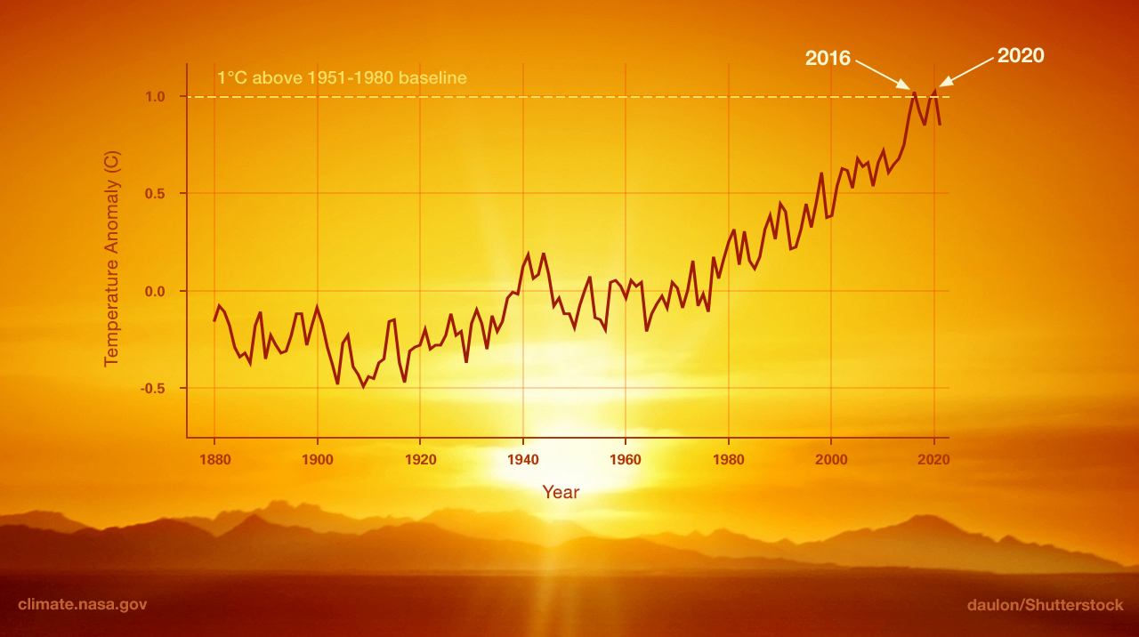
GHG Emissions
and Global warming
1880 to 2020 - Change in global surface temperature
Image credit: NASA/JPL-Caltech
Notes:
This graph from NASA’s Goddard Institute for Space Studies illustrates the change in global surface temperature relative to 1951-1980 average temperatures, with the year 2020 tying with 2016 for hottest on record.
Natural processes can contribute to changes in climate, but most climate scientists agree that this current warming trend is overwhelmingly due to human activities, primarily fossil fuel burning, since the dawn of the industrial age around the turn of the 20th century. The warming is increasing at an unprecedented rate. The resulting climate change is evident by diminishing glaciers, rising ocean levels, and more frequent and extreme climate and weather events such as droughts, hurricanes, and floods, affecting all regions globally. Science indicates that temperatures will continue to rise and that some of these changes will be irreversible for hundreds or thousands of years. However, if we can reduce emissions now, we may avoid some of the most damaging effects in the future.

Slide 29

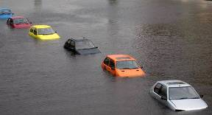
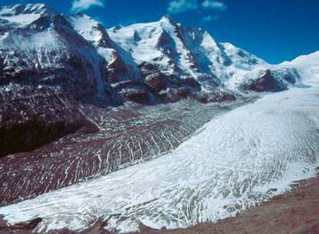
Global Warming Effects
Notes:
The terms “global warming” and “climate change” are sometimes used interchangeably, but "global warming" is only one aspect of climate change.
“Global warming” refers to the long-term warming of the planet. Global temperature shows a well-documented rise since the early 20th century and most notably since the late 1970s. Worldwide since 1880, the average surface temperature has risen about 1°C (about 2°F), relative to the mid-20th century baseline (of 1951-1980). This is on top of about an additional 0.15°C of warming from between 1750 and 1880.
“Climate change” encompasses global warming, but refers to the broader range of changes that are happening to our planet. These include rising sea levels; shrinking mountain glaciers; accelerating ice melt in Greenland, Antarctica and the Arctic; and shifts in flower/plant blooming times. These are all consequences of warming, which is caused mainly by people burning fossil fuels and putting out heat-trapping gases into the air.
Many scientists believe that global climate change is causing the polar regions to melt and sea levels to rise, increasing coastal erosion. Storms will become more frequent and intense and forest fires will rage at higher intensities, leading to human and ecosystem destruction.
It is appropriate that we as a nation try to reduce the impacts our buildings have on the global climate, if not the global pocketbook.
Image sources:
www.nst.com.my/Sunday/Focus/20070617084604/insidepix1
www.joanneum.at/climate/Pictures/Gletscher_small.jpg
www.thelastminuteblog.com/wp-content/uploads/2007/01/climate-change.jpg

Slide 30
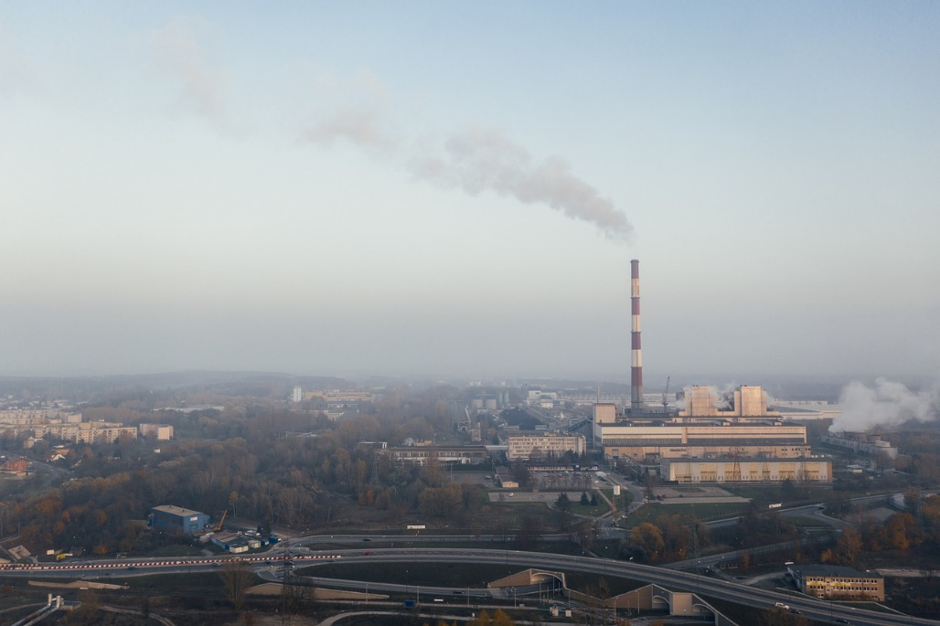

Health Impacts
Image by Marcin from Pixabay
Image by Jeff Yen from Pexels
Notes:
In addition to global warming and climate change, burning fossil fuels pollutes the air we breathe, causing many different health issues, including asthma, respiratory disorders, cancer, stroke, heart disease, and premature death. It has also been linked to Alzheimer’s disease and autism. Research from Harvard University, University of Leicester and University College London found that fossil fuel-based air pollution was responsible for about 1 in 5 deaths worldwide in 2018.
According to a report by the Medical Society Consortium on Climate & Health, Wisconsin Health Professionals for Climate Action, and Natural Resources Defense Council (NRDC), health costs related to climate change and fossil fuel pollution are estimated at about $820 billion per year in the U.S.
Sources:
https://www.hsph.harvard.edu/c-change/subtopics/fossil-fuels-health/
https://www.nrdc.org/sites/default/files/costs-inaction-burden-health-report.pdf

Slide 31
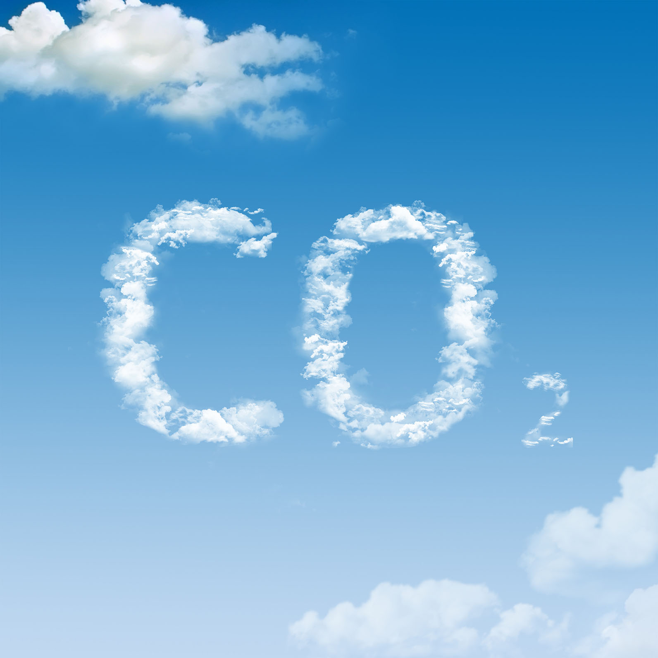
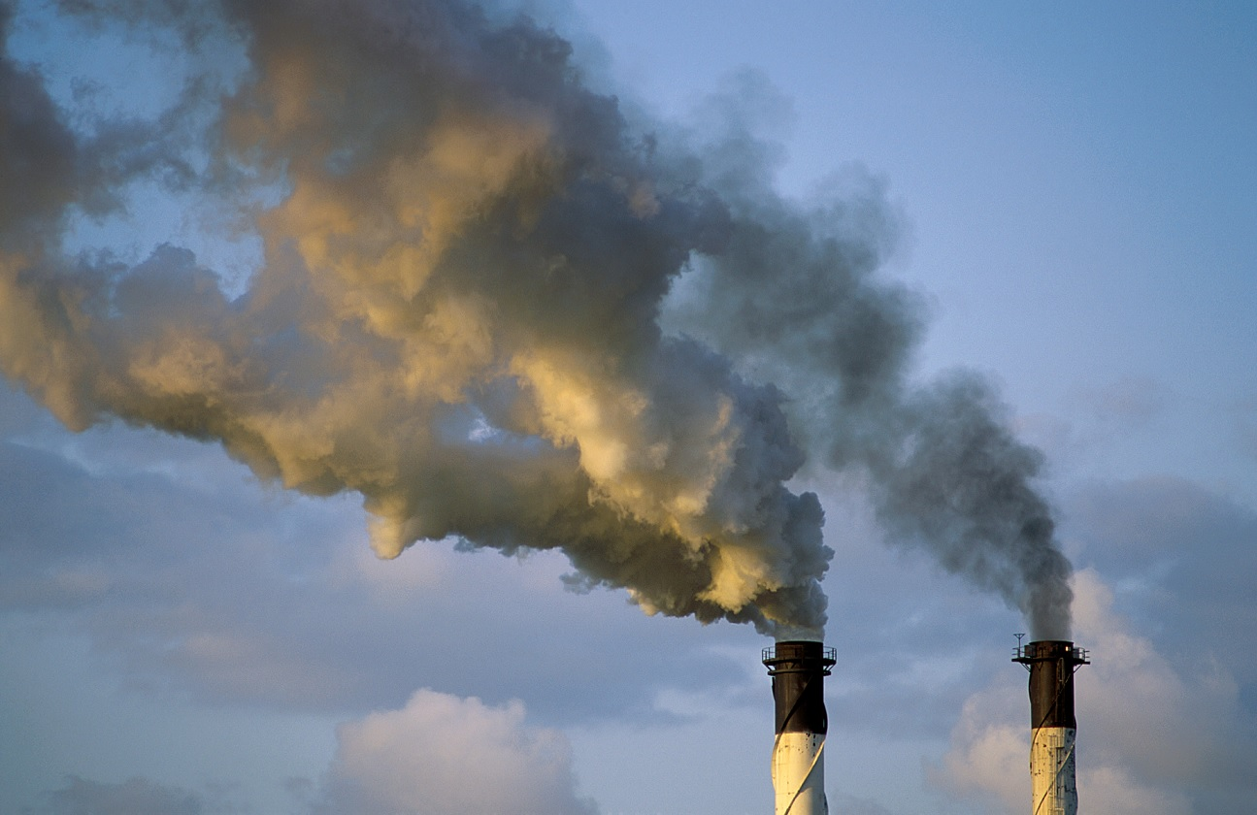
What is CO2?
Notes:
What is CO₂?
CO2 is carbon dioxide, an invisible, odorless and colorless gas. Like all gases, CO2 is made up of molecules that have weight; therefore, it can be measured in units of weight. For example, a balloon filled with air is heavier than an empty balloon due to the mass of the gas inside.
CO2 comes from combustion of combustible fuels such as coal, natural gas, oil, gasoline and more. All combustible fuels (except hydrogen), whether renewable or fossil, contain carbon.
Inside the flame, the carbon reacts with the oxygen in the air to produce heat and carbon dioxide. Chemists express this in a small formula:
C + O₂ = CO₂ + heat
And in terms of the weight of the various components, this represents:
1 kg of carbon
+
2.67 kg of oxygen give 3.67 kg of carbon dioxide and heat

Slide 32
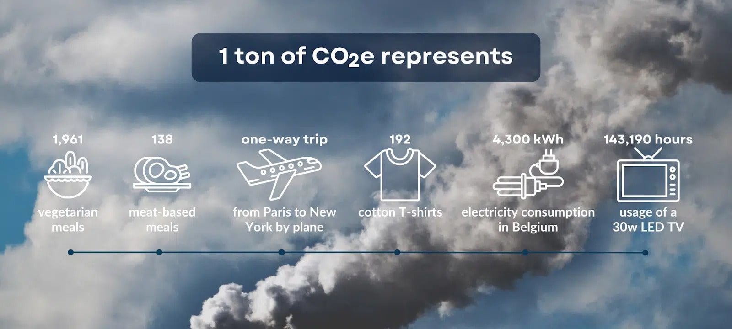
What is a ton of carbon?
Notes:
A ton of carbon dioxide is an abstract notion for most of us, but it deserves some explanation here. A ton of carbon is the standard measurement used in climate action plans which are developed by companies, organizations and governments to reduce their contribution to carbon emissions.
The chart above provides examples of various human activities that generate the equivalent of one ton of carbon, represented as CO₂e (carbon dioxide equivalent):
the average emission of one passenger on a return-flight from Paris to New York
4300 kWh of electricity consumption in Belgium*
138 meat-based meals
*3 months of electricity for a family of four; electricity is generated from predominantly gas-fired power plants.
Image source:
https://www.tapio.eco/blog/what-represents-one-ton-co2-emissions/

Slide 33
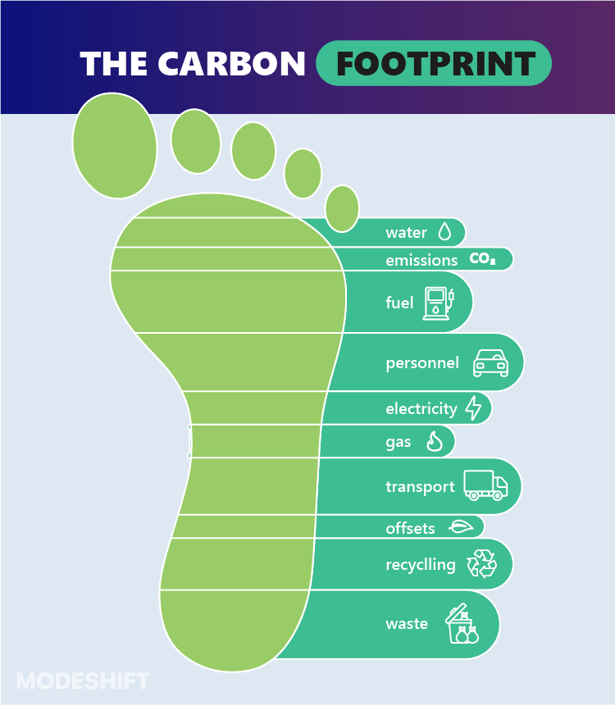
What is a Carbon Footprint?
Notes:
What Is a Carbon Footprint?
A carbon footprint is defined as the total amount of greenhouse gases emitted into the atmosphere, such as carbon dioxide (CO2), methane (CH4), nitrous oxide (N2O), hydrofluorocarbons (HFCs), expressed in equivalent tons of CO2. It is associated with the activities of an individual, a community, an organization, a process, a product or service, or an event, among other things.
Individual carbon footprint can thus be termed as the total amount of greenhouse gases produced by our personal actions such as transportation, household activities, clothing and food. A product’s carbon footprint measures the total amount of greenhouse gas emissions from its life cycle – from raw material extraction and production to the final use by consumers including recycling or disposal. A company’s carbon footprint determines the greenhouse gas emissions from across its operations, including power generation used in building structures, industrial activities, and machinery and equipment. The carbon footprint of a country considers the greenhouse gas emissions from total energy and material utilization, plants and other carbon sequestrations, as well as indirect and direct emissions from import and export processes.
Source: https://earth.org/what-does-carbon-footprint-mean/
Image source: modeshift.com

Slide 34
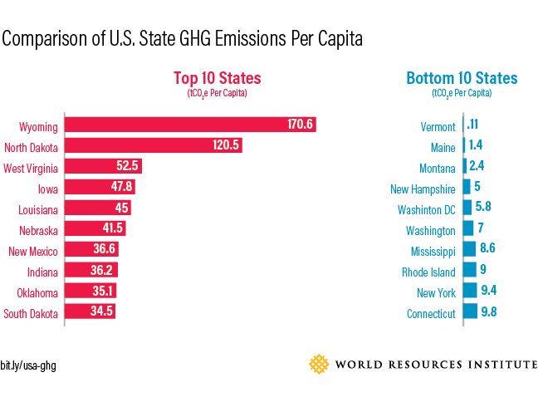
Carbon Footprint of US States
Notes:
This figure, from the World Resources Institute, compares the carbon footprint in GHG emissions per capita of various US states.
The top emitters are Wyoming and North Dakota, followed closely by West Virginia. These states are large producers of fossil fuel resources such as oil, coal and natural gas. Also of note, are Iowa and Louisiana. Iowa’s heavy agricultural industry, which includes both food and biofuel production, make it one of the most energy-consuming states in the country. Meanwhile Louisiana, with its abundant fossil fuel resources, has a high energy-intensive industry sector of oil refinery and natural gas production: energy use in Louisiana’s industrial sector contributed to almost half of its total GHG emissions.
New York, the third most populous U.S. state, is one of the country’s lowest per capita emitters. Since 2005 its electricity sector emissions have fallen by more than 45 percent as a result of a range of state-level energy policies that promote efficiency and renewable (such as the Regional Greenhouse Gas Initiative) as well as shifting market forces.
Source: https://www.ecosystemmarketplace.com/articles/6-charts-to-understand-us-state-greenhouse-gas-emissions/

Slide 35
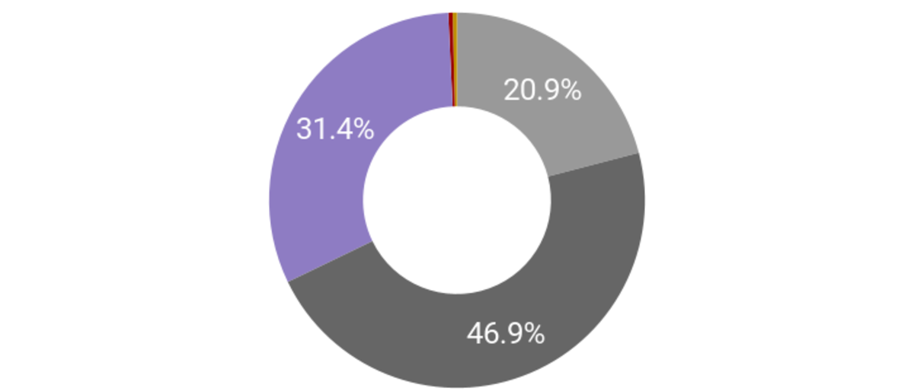
City of Boston Carbon Footprint
Wastewater Treatment & Compost
Fugitive Emissions
Small Residential
Transportation
Commercial, Industrial, Large Residential
Notes:
This image summarizes the carbon footprint calculated for the City of Boston for the year 2021. It shows the estimated percentages of total carbon emissions per various sectors.
Source: https://www.boston.gov/departments/environment/bostons-carbon-emissions

Slide 36
Exercise: Your Building’s Carbon Footprint
Take 10 minutes.
Read the questions about your building’s GHG emissions.
Write down your answers.
Share your answers during the group discussion.
Notes:
Think about a commercial building you work in or a spend a lot of time in. What are the sources of GHG emissions? List 2 or more GHG sources in each category.
Building systems and equipment (interior):
_____________________________________________________________________
Building systems and equipment (exterior):
_____________________________________________________________________
Landscape, grounds and parking:
_____________________________________________________________________
What is your company or organization doing to reduce GHG? For example, energy management or sustainability plans, energy efficiency projects, other?
_____________________________________________________________________

Slide 37
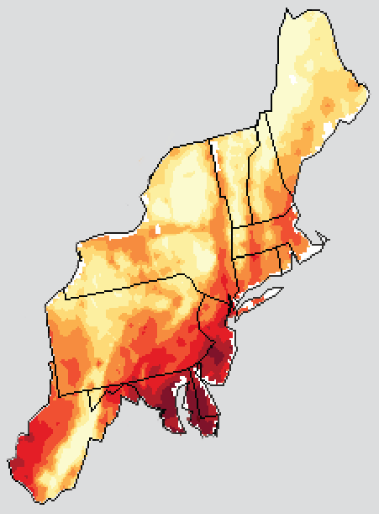
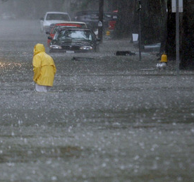
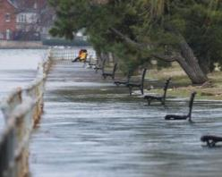
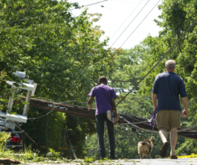
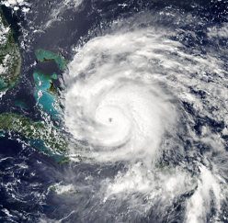
Local Climate Change Impacts
PRECIPITATION
SEA LEVEL RISE
Source: NCA 201
Number of days > 90ºF
HEAT
EXTREME WEATHER
STORM SURGE
Notes:
Many regions are already feeling the impacts of climate change and they are expected to get worse. Examples of some of these impacts include:
Heat: More extreme heat days above 90°F
Precipitation: Extreme precipitation events, when a large amount of rain/snow falls in a short period of time are projected to become more frequent and more intense
Sea level rise: Increase of 3.4 feet by 2080
Extreme weather: More extreme weather events with greater intensity
Storm surge: Fed by extreme weather, periods of intense precipitation and sea level rise
Wildfires: Increasing instances of large wildfires, causing poor air quality which can have dangerous health effects
Image source: Climate Ready DC Plan

Slide 38
Extreme Heat Events
Days over 95°F Heat Index
 | Baseline |  |  |  |  |  |  |  | 2020s |  |  |  |  |  |  |  | 2050s |  |  |  |  |  |  |  | 2080s
June | 1 | 2 | 3 | 4 | 5 | 6 | 7 |  | 1 | 2 | 3 | 4 | 5 | 6 | 7 |  | 1 | 2 | 3 | 4 | 5 | 6 | 7 |  | 1 | 2 | 3 | 4 | 5 | 6 | 7
 | 8 | 9 | 10 | 11 | 12 | 13 | 14 |  | 8 | 9 | 10 | 11 | 12 | 13 | 14 |  | 8 | 9 | 10 | 11 | 12 | 13 | 14 |  | 8 | 9 | 10 | 11 | 12 | 13 | 14
 | 15 | 16 | 17 | 18 | 19 | 20 | 21 |  | 15 | 16 | 17 | 18 | 19 | 20 | 21 |  | 15 | 16 | 17 | 18 | 19 | 20 | 21 |  | 15 | 16 | 17 | 18 | 19 | 20 | 21
 | 22 | 23 | 24 | 25 | 26 | 27 | 28 |  | 22 | 23 | 24 | 25 | 26 | 27 | 28 |  | 22 | 23 | 24 | 25 | 26 | 27 | 28 |  | 22 | 23 | 24 | 25 | 26 | 27 | 28
 | 29 | 30 | 1 | 2 | 3 | 4 | 5 |  | 29 | 30 | 1 | 2 | 3 | 4 | 5 |  | 29 | 30 | 1 | 2 | 3 | 4 | 5 |  | 29 | 30 | 1 | 2 | 3 | 4 | 5
July | 6 | 7 | 8 | 9 | 10 | 11 | 12 |  | 6 | 7 | 8 | 9 | 10 | 11 | 12 |  | 6 | 7 | 8 | 9 | 10 | 11 | 12 |  | 6 | 7 | 8 | 9 | 10 | 11 | 12
 | 13 | 14 | 15 | 16 | 17 | 18 | 19 |  | 13 | 14 | 15 | 16 | 17 | 18 | 19 |  | 13 | 14 | 15 | 16 | 17 | 18 | 19 |  | 13 | 14 | 15 | 16 | 17 | 18 | 19
 | 20 | 21 | 22 | 23 | 24 | 25 | 26 |  | 20 | 21 | 22 | 23 | 24 | 25 | 26 |  | 20 | 21 | 22 | 23 | 24 | 25 | 26 |  | 20 | 21 | 22 | 23 | 24 | 25 | 26
 | 27 | 28 | 29 | 30 | 31 | 1 | 2 |  | 27 | 28 | 29 | 30 | 31 | 1 | 2 |  | 27 | 28 | 29 | 30 | 31 | 1 | 2 |  | 27 | 28 | 29 | 30 | 31 | 1 | 2
August | 3 | 4 | 5 | 6 | 7 | 8 | 9 |  | 3 | 4 | 5 | 6 | 7 | 8 | 9 |  | 3 | 4 | 5 | 6 | 7 | 8 | 9 |  | 3 | 4 | 5 | 6 | 7 | 8 | 9
 | 10 | 11 | 12 | 13 | 14 | 15 | 16 |  | 10 | 11 | 12 | 13 | 14 | 15 | 16 |  | 10 | 11 | 12 | 13 | 14 | 15 | 16 |  | 10 | 11 | 12 | 13 | 14 | 15 | 16
 | 17 | 18 | 19 | 20 | 21 | 22 | 23 |  | 17 | 18 | 19 | 20 | 21 | 22 | 23 |  | 17 | 18 | 19 | 20 | 21 | 22 | 23 |  | 17 | 18 | 19 | 20 | 21 | 22 | 23
 | 24 | 25 | 26 | 27 | 28 | 29 | 30 |  | 24 | 25 | 26 | 27 | 28 | 29 | 30 |  | 24 | 25 | 26 | 27 | 28 | 29 | 30 |  | 24 | 25 | 26 | 27 | 28 | 29 | 30
 | 31 |  |  |  |  |  |  |  | 31 |  |  |  |  |  |  |  | 31 |  |  |  |  |  |  |  | 31 | 1 | 2 | 3 | 4 | 5 | 6
 |  |  |  |  |  |  |  |  |  |  |  |  |  |  |  |  |  |  |  |  |  |  |  |  | 7 | 8 | 9 | 10 | 11 | 12 | 13
 | 30 days |  |  |  |  |  |  |  | 50 days |  |  |  |  |  |  |  | 70-80 days |  |  |  |  |  |  |  | 75-105 days
 |  | Days above 95°F Heat Index (low emission scenario) |  |  |  |  |  |  |  |  |  |  | Days above 95°F Heat Index (high emission scenario)
Notes:
Especially critical from a public health perspective is the projected increase in the number of dangerously hot days – those when the heat index climbs above 95°F. The graph above depicts a heat index of historic and projected data of days above 95°F for the Washington, D.C. metro area.
The number of such days is expected to more than double by mid-century, and by 2080 the entire summer could be dangerously hot.
This will have significant impacts on energy demand for cooling, in addition to increasing heat related illnesses and deaths.
Source: Climate Ready DC Plan

Slide 39
Trends in Building
Operations
Increase in demand for credentialed operators
Federal Buildings Personnel Training Act
O&M practices driving high performance
More focus on whole building tuning
Low cost/no cost processes and adjustments
Need for electrification-related skill sets
Notes:
Building operators work in a variety of places including factories, hospitals, hotels, office and apartment buildings, schools, real estate firms, and shopping malls. Some are employed as contractors to a building or plant. In recent years, the demand for credentialed operators in facility and property management has grown as employers seek assurance that their building operations personnel have the knowledge to safeguard the value of building stock, comply with evolving energy codes, and carry out mission-critical directives to drive down energy usage and costs.
In 2010, Congress enacted the Federal Buildings Personnel Training Act which requires federal building personnel to be trained in energy-efficient operations. The goal of the legislation is to ensure an adequate pool of skilled building operator technicians to support energy-efficiency projects mandated by energy-efficiency legislation and programs.
Many companies are adopting building rating systems such as ENERGY STAR and LEED to improve energy performance. ENERGY STAR certified buildings use, on average, 35 percent less energy than similar buildings nationwide (Energy Star 2020). The LEED for Existing Buildings: Operations & Maintenance (LEED-EBOM) rating system, for which building technicians play a significant role, has experienced explosive growth.
Many states have enacted building energy disclosure laws requiring building owners to publicly report annual energy use. Energy disclosure improves building management and overall performance while spurring competition and demand for energy-efficient buildings. Building operators can play a significant role in collecting, reporting, and using building energy performance data. From a professional development perspective, this marks a significant impact on the technician’s skill set with regards to data mining processes and technologies, and team-based processes like energy audits, commissioning, and retro-commissioning initiatives.
Other recent trends point to growing demand for new skill sets and credentialing for building technicians. Faced with high energy costs, businesses are adopting practices and hiring skilled workers to help them achieve energy efficiency. According to a 2019 Energy Efficiency Indicator survey by Johnson Controls, 73 percent of respondents noted that greenhouse gas footprint reduction is extremely or very important. Green building certification continues to grow, with 76% planning to achieve voluntary certification compared with 58% in 2018. (Johnson Controls, 2019).
Awareness of heat pump technology as a cost-effective method of achieving efficient operations has increased. Another benefit of heat pumps is that they use electricity rather than fossil fuels. As greenhouse gas reduction efforts ramp up, many jurisdictions are mandating decarbonization requirements. One of the most effective means of decarbonization in buildings is electrification, which means replacing fossil fuel consuming equipment with electrified equipment such as heat pumps. Since heat pumps utilize refrigeration technology, there is an increasing need for building operations professionals to be familiar with the associated operations and maintenance (O&M) skills for refrigeration-based equipment.

Slide 40
Energy Conservation Efforts
New Construction Commissioning
Energy Audits
Retro-commissioning
Notes:
Common energy conservation efforts include:
Commissioning – performed at the time of construction and determines if equipment is installed and operating as designed
Energy Audits – walk-through identifying opportunities for energy and cost savings and recommendations for improvement
Retro-Commissioning – commissioning process performed for existing buildings
Each one of these has benefits and disadvantages and are appropriate at various times of the lifecycle of the facility.
However, all of these are unique events that occur. What happens when this event is over?

Slide 41
Energy Conservation Efforts
Notes:
A typical trend with an energy conservation effort is that significant savings is seen after the event but over time, the energy starts to creep up again. This graph shows a typical case when you have no retuning and over time, the energy starts to increase as old behaviors come back or we abandon the revised processes.
The energy conservation effort is not long lasting and does not change behavior or continue through the operations.

Slide 42
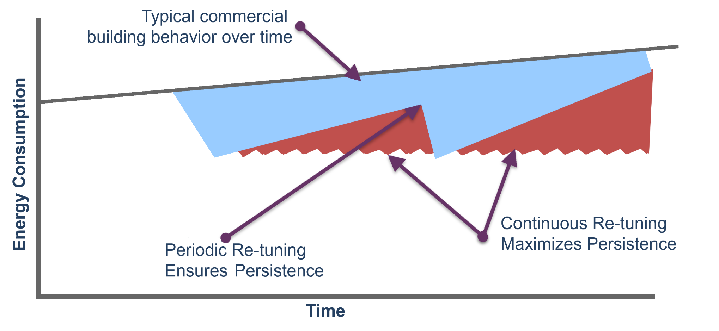
Energy Conservation Efforts
Notes:
Typically, building energy consumption increases over time without intervention. This can be from many causes including usage change, occupant changes, and operational issues such as:
set-backs overridden or not set up properly
occupancy schedules incorrect
inadequate insulation or weather stripping
start time for cooling or heating in morning earlier than needed
Re-tuning is a process where the building is optimized for efficient operations. This chart shows along the top a building without retuning, with periodic retuning and continuous retuning.

Slide 43
Building Optimization
Going Back To Basics
Continual Optimization
Awareness
Education
Notes:
Building optimization, or re-tuning, can be thought of as taking us back to the basics of how to run our buildings and is often considered a scaled down version of commissioning.
Its primary focus is to identify and correct building operational problems that lead to energy waste.

Slide 44
Building Optimization Focus
Focus on optimization of building operations
Looking at entire building; all systems plus exterior
Tests and corrective actions that are the most impactful and can be made with limited time and resources
“…up to 20% of energy used in commercial buildings is wasted because of improper and inefficient operations”
-PNNL

Slide 45
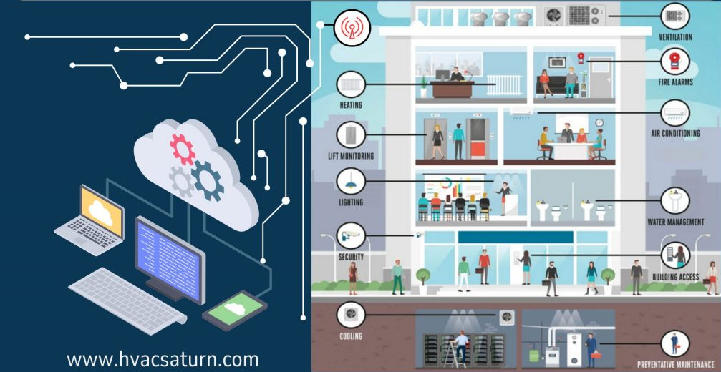
Your Facilities Are Like
Living Organisms
Consider effects of one change on the entire system
Building Automation
System (BAS)
Image source: hvacsaturn.com/bas
Notes:
A building operates in a similar way to the human body. For example, a building automation system (BAS) is like the brain, doing the “thinking” by receiving, processing, and outputting information to control the system.
The effects of a single change can often be “felt” throughout the building. If I pinch you, you will feel pain and you might scream. If you don’t scream, I may think everything is fine, even if you are indeed in pain. The BAS sends the pain signal that lets you know something is wrong.
Building re-tuning can help identify some of this “pain” despite not being as obvious as an alarm or other clear indication of a problem.

Slide 46
Core Principles
If you don’t need it… turn it off.
If you don’t need it at full capacity…
turn it down.
If it is status quo, ask why?
Notes:
Three basic core principles of building re-tuning apply to running our buildings effectively and efficiently.
These are basic principles we can employ on a daily basis.

Slide 47

Core Principles
If it is status quo, ask why?
Questions
Actions
Why is the temperature set at this level?
Why is equipment turned on at 6:00 am?
Who made that decision?
Do those conditions still exist?
If conditions have changed, try new settings
If people who made the decision are gone, revaluate the decision
Consider trying new ideas
Image: Unknown Author, licensed under CC BY

Slide 48
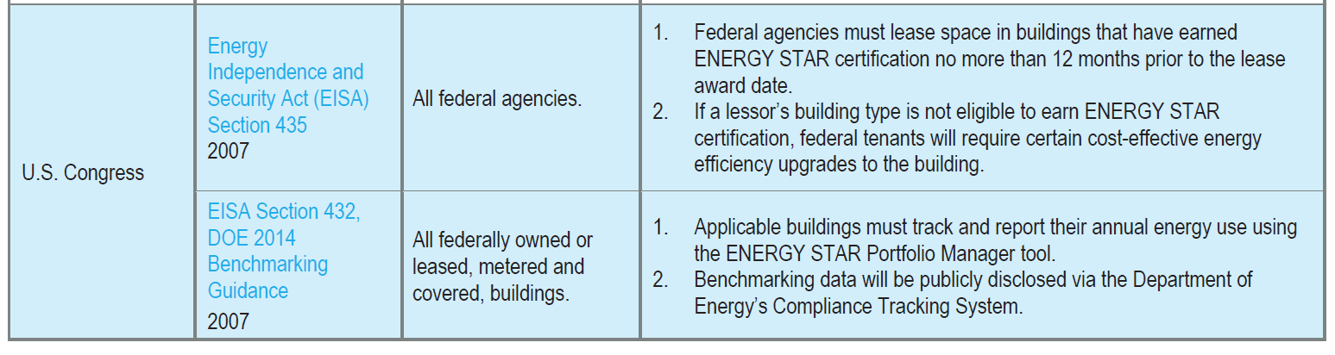
Building Codes & Mandates
Federal Level: One primary law
State and City Level: Varies
Notes:
There may be regulatory requirements that mandate action in terms of energy management. These requirements can be at the federal level or the State or City level.
There is one primary law at the federal level that applies to federal agencies, the Energy Independence and Security Act.

Slide 49
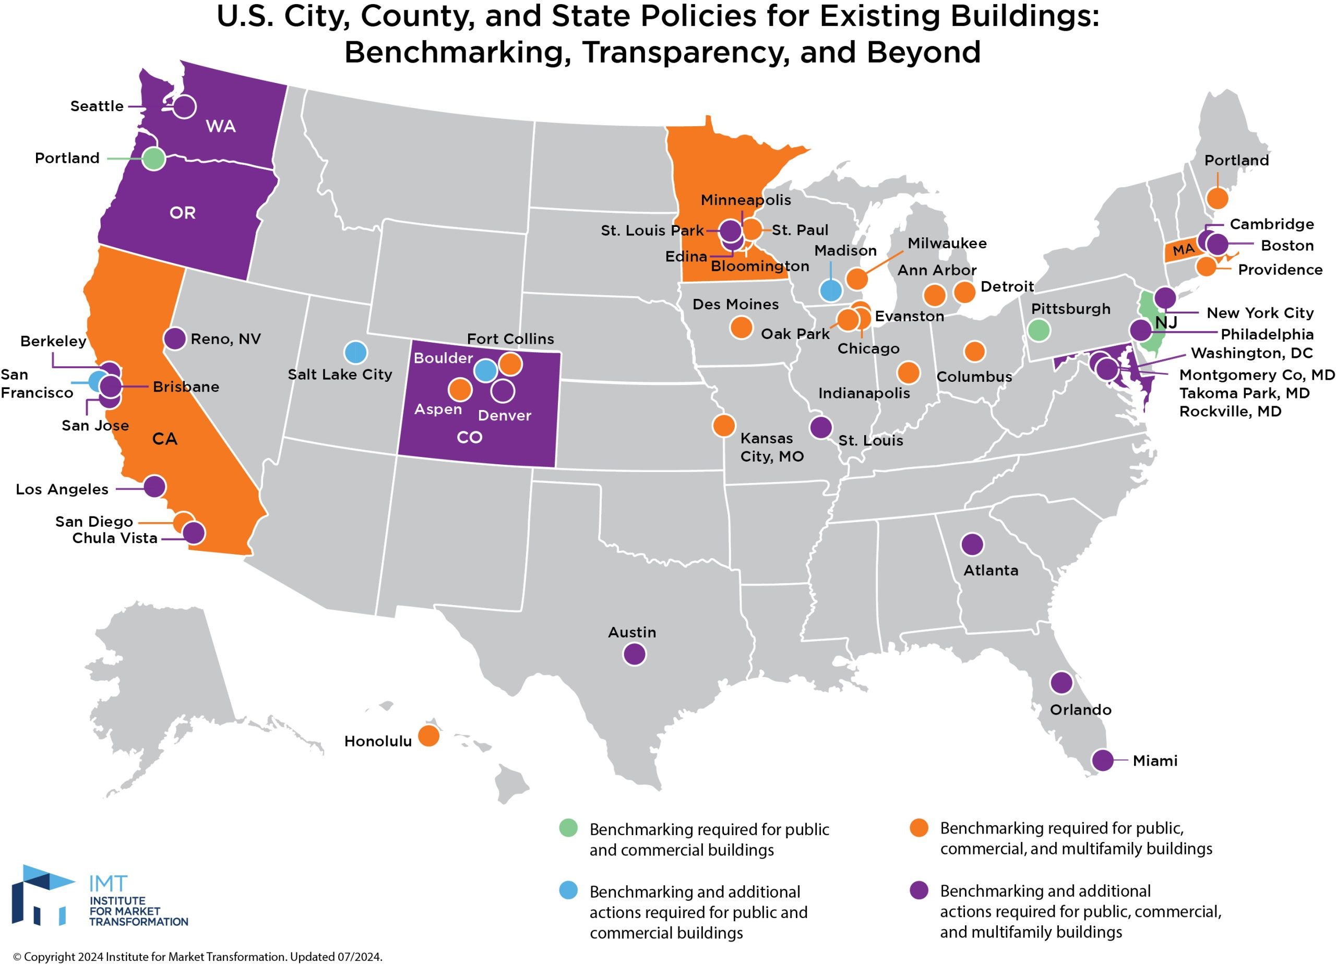
States and Cities with Benchmarking Policies
Vermont
Pittsburgh
Philadelphia
Michigan
New York
Mass
DC
Pennsylvania
Illinois
Indiana
Ohio
West Virginia
Kansas
Missouri
Roswell
Virginia
Kentucky
Atlanta
North Carolina
Oklahoma
Tennessee
Arkansas
South Carolina
Mississippi
Alabama
Georgia
Texas
Louisiana
Notes:
A benchmark is a standard by which something can be measured or judged. Benchmarking allows you to compare the energy performance of your building over time (e.g. year to year) or against similar facilities or an established level of performance. Benchmarking can also be performed for water use, waste, or greenhouse gas (GHG) emissions.
The highlighted states and cities are those that have some type of energy benchmarking requirement. Visit the website for the Institute for Market Transformation (IMT) for more details on individual requirements.
Link:
https://imt.org/resources/comparison-of-commercial-building-benchmarking-policies/
Image source: https://imt.org/resources/map-u-s-building-benchmarking-policies/

Slide 50
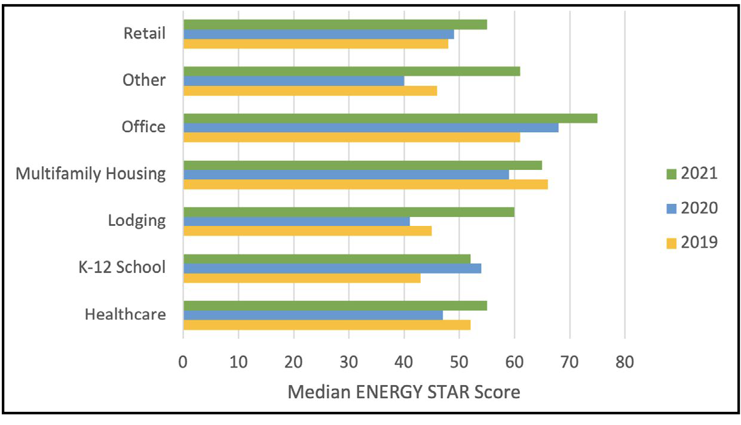
Source: https://www.chicago.gov/content/dam/city/progs/env/Energy-Benchmark-Reports/2021%20Chicago%20Energy%20Benchmarking%20Report.pdf
Chicago’s Benchmarking Policy Results
ENERGY STAR Scores by Building Sector Reported from 2019-2021
Notes:
Understanding how buildings are performing over time is an important metric. The chart above shows that Chicago’s benchmarking policy led to increases in energy efficiency and decreases in energy costs for building owners benchmarking their buildings year over year from 2019 to 2021.
Approximately 2,300 properties that benchmarked and reported in 2019 and again benchmarked and reported in 2021 (three consecutive reporting years) saw a decrease in total net energy costs of approximately $118.7 million. This is large in part due to substantial electricity cost savings seen for both commercial and residential properties included in the analysis, totaling approximately $99.4 million. These properties saw a reduction in energy use per sq. ft. by 6.5%, based on the median weather-normalized source energy use per sq. ft. from 2019 compared to 2021 (which takes into account changes in weather from year to year, as well as changes in the property size). These results suggest that the majority of properties continue to improve energy efficiency and achieve savings even after multiple years of required energy benchmarking, which went into effect for all properties over 50,000 sq. ft. in 2016.

Slide 51
Check Your Knowledge
“If you don’t need it, turn it _______.”
On
Off
Up
Around

Slide 52

Building a Plan for Your Facilities
Determine baseline and set goals
Identify energy saving opportunities
Monitor energy consumption
Measure success
Notes:
Follow these steps to build a plan for improving operations at your facilities.
We will talk about determining your energy consumption baseline later in the class.
For now, let’s talk about goals and understanding key performance indicators.

Slide 53
Starting with the end in mind…
Building a Plan for Your Facilities
Goal 3
Goal 1
Goal 2
Goal 4
Notes:
Setting goals means thinking about the outcomes you want to achieve.
It is important to think through your goals and determine what makes sense for your facility and what will align with your organization’s goals.

Slide 54
Determine Baseline
Target
Baseline
Notes:
It is important to know where you stand now before you set your goals. This is your baseline. With energy, we typically will look at what our current energy consumption is, or perhaps our renewable energy percentage, depending on our organization’s priorities. Knowing where you are now helps define where you can go.

Slide 55
Building a Plan for Your Facilities
Provide safe and healthy facilities by delivering quality facility services
Be the best widget producer in our industry
Extend and preserve life
Preserve our nation’s treasures
Maximize profit to our investors
Be a world class educational institution
Notes:
Understanding what is important to your organization is the best place to start.
Who are you? What is important to your organization? How does your facilities team help meet that mission? What does success for your team look and feel like? Alternatively, what does failure look like?

Slide 56
Building a Plan for Your Facilities
S
Specific
Well-defined and clear goals
M
Measurable
How will you determine if you are successful?
A
Achievable
Challenging but achievable
R
Relevant
Achievement in your area of focus
T
Timely
When you want you achieve this goal
Notes:
Follow the SMART principles when setting your goals.
This helps you develop a goal that is challenging, but is one that aligns with your organization’s overall goals and that you can track progress to determine if you are successful.

Slide 57
Building a Plan for Your Facilities
Facilities Mission
Provide safe and efficient facilities by delivering quality facility services
Energy Goal | Initiative
Decrease energy consumption by 20% | Implement operational changes
Become ENERGY STAR certified | Perform lighting retrofit
Notes:
Here is an example of two goals that can be tied back to the mission and vision of a facilities organization to provide efficient facilities.

Slide 58
Building a Plan for Your Facilities
Metrics vs. KPIs
Metrics
KPIs
A KPI is a core metric that defines top level success
Notes:
Not all metrics are the same. Key performance indicators (KPIs) are those metrics that define top level success and allow you to measure performance against key business objectives.

Slide 59

Building a Plan for Your Facilities
“We like to think that more information drives smarter decisions; that the more details we absorb, the better off we'll be.”
-Ron Friedman
Why Too Much Data Disables Your Decision Making
Notes:
More is not always better. In many instances, people are not effective in measuring performance because they got overwhelmed with the amount of data presented to them. Too much data disables your ability to make data-driven decisions. Understanding your KPIs and what data will actually help you make decisions is crucial to your success.

Slide 60
Check Your Knowledge
Which of the following are included in the SMART principles for objectives?
Specific
Measurable
Actionable
Relevant
a, b, and d

Slide 61
Building a Plan for Your Facilities
Determine baseline and set goals
Identify energy saving opportunities
Monitor energy consumption
Measure success
Notes:
To build a facilities plan, start by determining a baseline and setting your goals.
Next, identify energy saving opportunities by performing building re-tuning or another similar exercise.
You will then need to continually monitor the energy consumption in your facilities.
Finally, measure success based on your observations and findings.

Slide 62

Learning Activity #1
Breakout Groups
Determine Your Baseline & Setting Your Goals
Turn to the Appendix of your handbook
Notes:
Please turn to the Appendix of your handbook to complete Activity 1.

Slide 63

Green Building:
An approach to design, construction and operations that conserves resources while it protects human and environmental health
“A ‘green’ building is a high performance facility that reduces water, energy and resource consumption, lowers operational costs, improves indoor air quality, and mitigates negative environmental impacts.”
(District of Columbia Department of Environment Guide To Green Buildings)
Notes:
What is a Green Building?
Green building includes sustainable design, responsible construction, and operating in a manner to conserve resources and protect human health.
Source: https://doee.dc.gov/sites/default/files/dc/sites/ddoe/publication/attachments/GuideToGreenBuildings.pdf

Slide 64
Green Building Certification
What is certification?
Confirmation that a product meets the criteria of a standard
What is green building certification?
A system that rates or rewards relative levels of compliance or performance with specific environmental goals and requirements.
Notes:
A certification is a confirmation that a product meets defined criteria of a standard. ISO defines certification as: "any activity concerned with determining directly or indirectly that relevant requirements are fulfilled."
Green building rating or certification systems rate or reward relative levels of compliance or performance with specific environmental goals and requirements. Rating systems and certification systems are frequently used interchangeably. The table identifies the building rating systems most commonly in use within the U.S. and Canada in the private and public sectors.
Green building rating and certification systems require an integrated design process to create projects that are environmentally responsible and resource-efficient throughout a building's life-cycle: from siting to design, construction, operation, maintenance, renovation, and demolition.
A few of these programs are single-attribute, focusing solely on water or energy. ENERGY STAR certification and Net-Zero Energy (NZE) certification are examples of single-attribute guidelines.
Others are multi-attribute addressing emissions, toxicity, and overall environmental performance in addition to water and energy. Green Globes, LEED, and Living Building Challenge certifications are examples. While the philosophy, approach, and certification method vary across these the systems, a common objective is that buildings awarded or certified within these programs are designed to reduce the overall impact of the built environment on human health and the natural environment.
Green building rating systems exist to address every building type from single-family houses and commercial buildings to entire neighborhoods. There are rating systems available for new construction, which focus on decisions made in the planning and design process and actions taken through construction, as well as for existing buildings, which focus on operations and maintenance throughout the life of the building. A primary reason for the creation of rating systems is the need to more clearly define, implement, and measure “green.” Federal, state, and municipal agencies across the country such as the General Services Administration (GSA), Department of Energy, Department of Health and Human Services, and the Environmental Protection Agency, have taken an early lead in incorporating energy efficiency and sustainability by following green building guidelines in the design, construction, and renovation of Federal facilities. Most states and many major cities have also incorporated green into their internal building requirements for new construction.
Source: U.S. Department of Energy

Slide 65
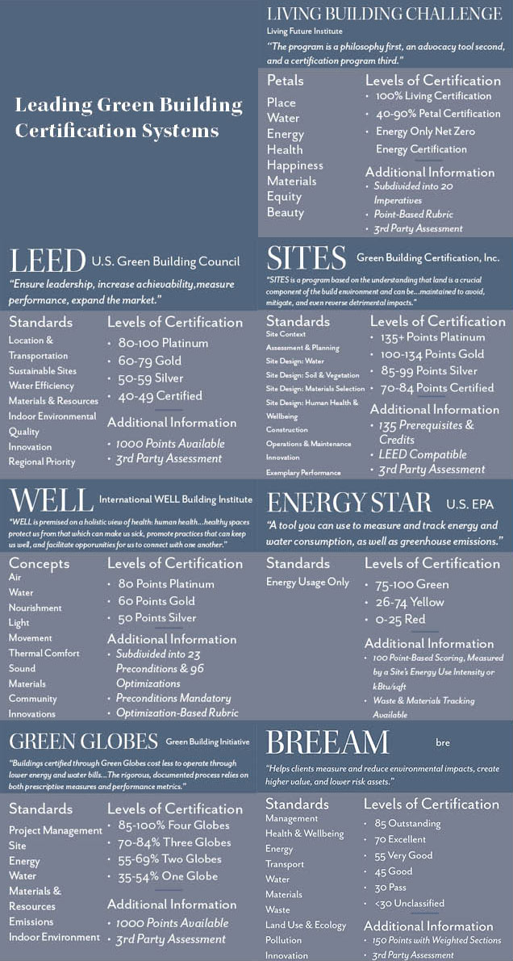
Green Building Certification Guidelines
Notes:
In 1995, the 10-member U.S. Green Building Council began designing its groundbreaking green building rating system, called LEED, which stands for “Leadership in Energy and Environmental Design”. This national rating system provides benchmarks with which new and existing buildings can measure their performance compared with similar buildings throughout the country.
In just a decade, the USGBC has grown from 10 to over 13,000 organizational members. Though LEED for New Construction (NC) used to receive most of the publicity, LEED for Existing Buildings: Operations and Maintenance (EBOM) has gained momentum in recent years. While the number of buildings is different in each category, the total square footage of space is almost equal between the NC and EBOM systems: approximately 1.19 billion square feet each. LEED certified projects are encouraged to pursue EBOM certification. To date, over 6,850 buildings are certified in LEED EBOM and certifications continue to grow at a rate of forty buildings per month. A 2006 US Green Building Council study found that by retrofitting buildings, owners can save on average 90 cents per square foot annually in energy and other costs and earn back their investment in 2 to 2 ½ years.
Images Source: https://www.biohabitats.com/newsletter/the-living-building-challenge/_green-building-certification-comparison/

Slide 66
Green Building Certifications, continued
Source: Living Building Challenge
Notes:
Since LEED was created, many other useful green building certification systems have emerged in the market. The chart on these two pages feature seven of the leading certification systems into a basic reference guide. As you can see, the rating systems hold several values, principles, and standards in common. For the most part (apart from Energy Star which considers energy use only), the tiered rubrics consider many of the same categories: health, resources, environmental impact, materials—if only phrased and weighted a little differently.
Green Globes was introduced in the US in 2004. It originated from the European Building Research Establishment's Environmental Assessment Method (BREEAM) system. It offers an alternative rating system to LEED and is recommended by the US General Services Administration for its Federal Buildings.
Living Building Challenge was introduced globally in 2009 under the auspices of the International Living Building Institute. The Institute certified the first projects in 2010, which changed the green building movement on a fundamental level. Groups from Mexico, Ireland, Australia, Germany, Israel and other countries around the world reached out to learn more about the Living Building Challenge and to forge formal ties with the Institute, underscoring the truth that people from all parts of the world are looking for hopeful, practical responses to environmental, social and economic difficulties.
Given the complicated nature of designing, building, and operating infrastructure—especially of the innovative green type—and the fact that these certification systems are often evolving being updated with new versions, deciding which system is the best fit for your project requires careful research and discussion with your building management team.
These certification systems aren’t the only systems or checklists created to assist companies to “go green” and save energy. Energy Star was created in 1992 by the EPA and Department of Energy as a labeling program to promote the use of energy efficient products and practices. In 2007 alone, Americans saved over $18 billion on their utility bills, avoiding the greenhouse gas emissions equivalent to 27 million cars. With energy-tracking tools like Portfolio Manager, building operators can identify underperforming buildings and measure the effects of improvements in systems and operations, helping improve decision-making.

Slide 67


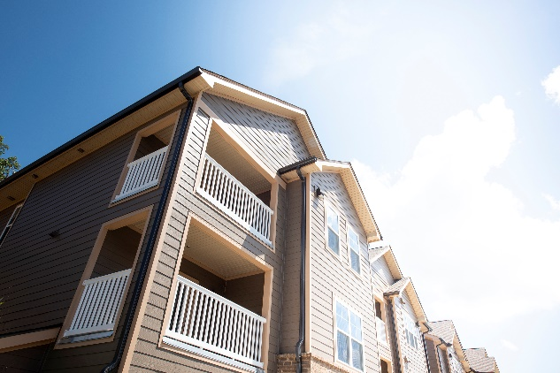

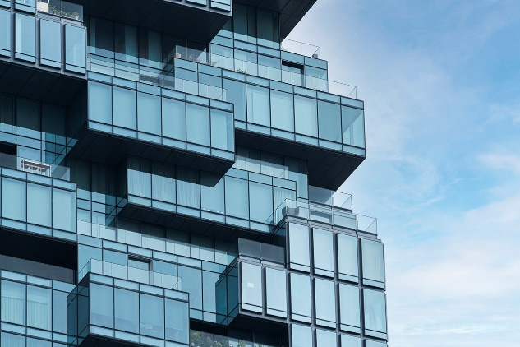
Sustainable Sites
Start with location.
Notes:
The most sustainable buildings enhance existing neighborhoods, urban infrastructure, and transportation systems. They provide sustainable options for travel to and from the site, reduce the amount of fossil fuels for daily roundtrips, and are located near services and amenities people use.
Operations staff support site improvements by:
making bike storage systems safe and accessible, encouraging more staff members to ride to work.
providing access paths to bus stops that are clearly marked and well maintained.
providing preferred carpool and/or EV parking stalls.
maintaining showers and changing rooms for people who bike or walk to work.
ensuring that night lighting operates well.

Slide 68
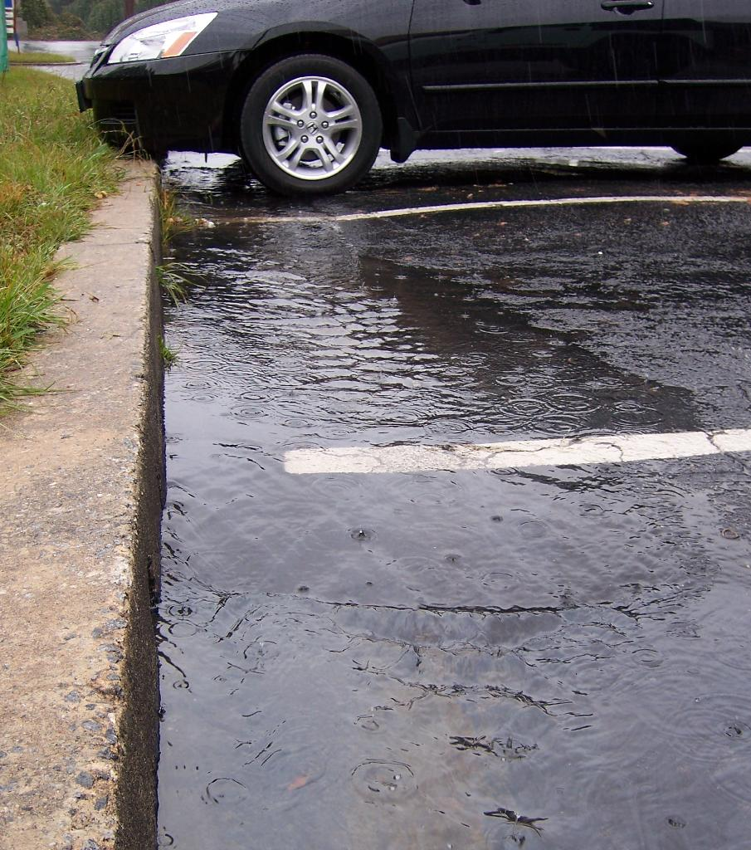
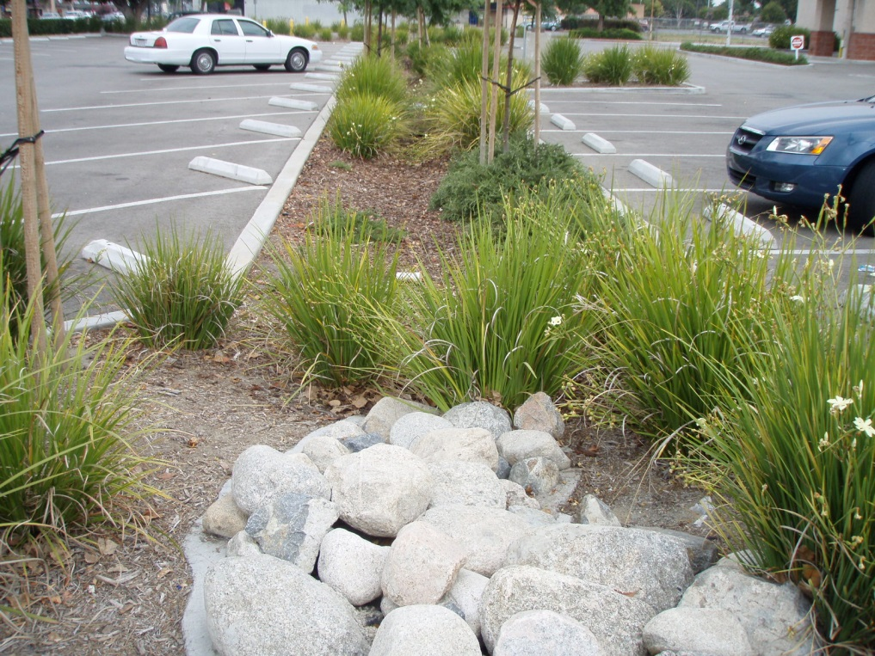
Stormwater Management
Or this?
This?
Notes:
In a natural ecosystem, rain falls and is slowed by tree canopies and natural plant cover. It is then absorbed by soils. Our urban environments with their hard surfaces require infrastructure to handle stormwater that can’t be absorbed back into the ground.
Low-impact development (LID) standards are now in place in many cities. The goal is to re-establish and/or mimic natural systems that recharge ground water. LID methods help Mother Nature to manage stormwater for us.
This?
Or this?
Or this?

Slide 69

Heat Island Effect
Shading
Reflective Materials
Vegetated Roof or Paving
Notes:
Heat Island Effect is when the temperature of an urban area is elevated higher than the surrounding countryside. This is due to pavement and buildings absorbing heat throughout the day at higher rates than vegetated countryside.
Ways to reduce heat island effect are:
Provide vegetated or architectural elements that shade hardscapes on a property.
Use paving and roofing materials that reflect light or resist heat gain from direct sunlight.
Use vegetated roofing or landscaping. These tend to use the sunlight instead of converting it to heat as paving does.
Photo: The six-acre green roof on the Vancouver Convention Centre, Vancouver, B.C., Canada.

Slide 70
Water Efficiency
Notes:
Over 80% of the water used in a typical commercial building is consumed by the heating/cooling system and in restrooms. Look to these areas for conservation strategies with quick payback.

Slide 71



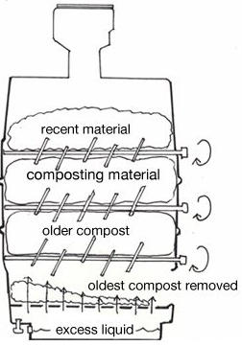
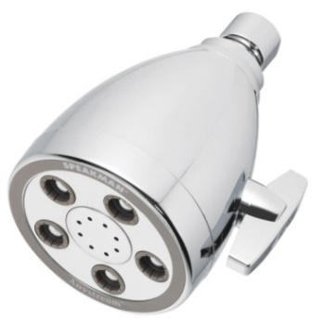
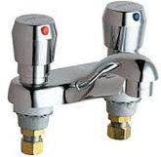
Fixtures That Conserve
Urinals: 0.5 gpf
Toilets: 1.28 gpf
Showerheads: 2.0 gpm
Lavatory Faucets: 0.5 gpm
Automatic Sensors
Kitchen Facilities
Notes:
Waterless Urinals use a fluid (chemical) to create a vapor trap in the drain line in place of water. This fluid is lighter than urine, allowing the urine to pass through. Over time, through drops passing with the urine and evaporation, chemical volume reduces, and odor increases. It is not typically recommended to “upgrade” to waterless urinals where they have not been previously specified unless the slope of the waste pipe is sufficient to flow very low volumes of fluids. Check local building codes for Gallons per flush (GPF) requirements. CALGreen 2013 allows an effective flush of 0.5 gpf urinals, for example.
WaterSense labeled High Efficiency Toilets (HET) are modern water-efficient toilets that are designed to use 1.28 GPF or less and meet the Maximum Performance Testing (MaP) threshold of 350 grams of waste removed from the toilet fixture in a single flush. MaP is a voluntary testing program and a major driving force in the improvement of toilet flush performance in North America.
Dual Flush Toilets offer two flush volumes depending on the type of waste being disposed. Typical volumes per flush are 1.28 and 0.8 gpf for commercial and residential style fixtures. Commercial flush valves are available and may be compatible with existing bowls. Operation varies by manufacturer, but they consist of two main types: (1) two buttons of differing sizes and (2) embossed logos and single levers with differing up and down actions. Many manufacturers provide educational materials/signage. Consider Water Sense rated fixtures and use Mass Per Flush (MPF) ratings. Some manufacturers offer kits to retrofit an existing tank toilet into a dual flush toilet. At about $20 each, these work very well and can be installed easily, however test one fixture prior to purchasing kits for more fixtures as some can not be modified.
Pressure and Vacuum-Assist Toilets – Typical flush volumes are 1 to 1.1 gpf. These use water pressure to “push” or create a vacuum that “pulls” the contents of the bowl to the waste pipe. This type is more prone to mechanical adjustments and failure due to the complexity of fixture. Consider using results from Maximum Performance testing for water closets when choosing upgrades. Low water use will not be realized if multiple flushes are needed to remove waste from the bowl. Waste pipe slope, diameter and pipe build up all have an effect on the amount of mass and the distance that it can be transported.
Composting Toilets - Composting toilet systems are available for small commercial buildings. They save large amounts of water and are comparable in terms of experience for the user to conventional toilet systems. The unique maintenance requirements for these systems can be minimal but must be adhered to. These systems need to be approved by the local jurisdiction, as not all jurisdictions allow them.
Showerheads – Since showers are typically 5 minutes or longer, reduce flows as much as feasible to reduce water consumption. Care must be taken to provide enough flow such that shower times are not increased, resulting in similar or increased water consumption than standard fixtures. The lowest recommended type is 1.75 gallons per minute (gpm) although a recently released 1.5 gpm is definitely worth considering.
Lavatory Faucets – With good aerators, flows (gpm) can be reduced without significantly impacting user experience or ability to remove soap. Since occupants use these faucets each time they use the restroom (we hope), reductions here can add up to significant savings.
Automatic/Sensor Fixture Operation – Automatic sensors provide a more hygienic environment while reducing flow duration (faucets) and improving reliability of flush volumes where user error may contribute to over flushing (hold a button or lever too long). However, sensors on toilets do not save money and often flush more often than they need to, so they use more water. Sensors are available for all restroom fixtures and types, even dual flush toilets which use sit-time as the basis of deciding which flush mode to use.
Kitchen Facilities – Typically flows on kitchen water faucets are not reduced because it takes a certain volume of water to complete a task. Focus on reducing water consumption of equipment such as dishwashers and single-pass equipment including drain water coolers.
Resources:
California Urban Water Conservation Council
https://wateractionhub.org/organizations/290/d/california-urban-water-conservation-council/
WaterSense - US EPA water conservation fixture labeling program
https://www.epa.gov/watersense

Slide 72
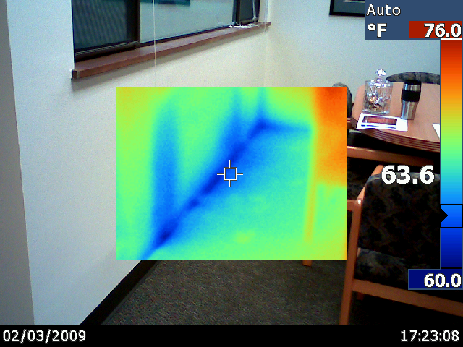
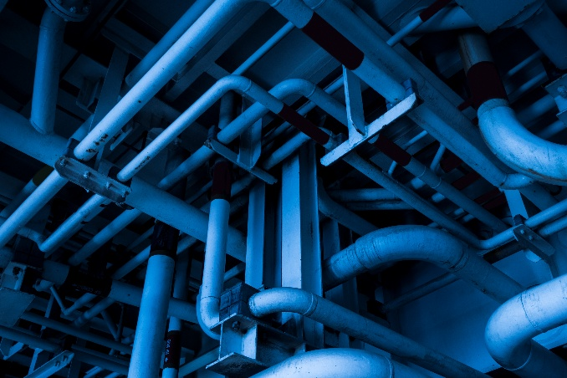

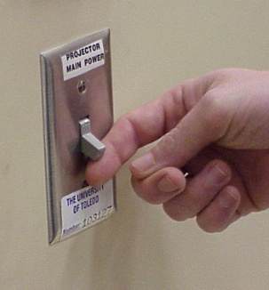
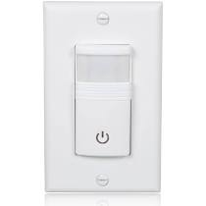
Energy Conservation
Notes:
This course will cover the fundamentals of energy conservation through operations and maintenance opportunities. Good energy management is a fundamental component of green buildings.

Slide 73
Indoor Environmental
Quality (IEQ)
Indoor Environmental Quality
Comfort
Productivity
Occupants
Notes:
We will have a section on indoor environmental quality (IEQ) in this course and discuss this in more detail. The quality of the indoor environment impacts our work life and productivity.
A 2015 study found that the productivity increase from improved ventilation alone is worth more than 150 times the energy costs of such a measure. And ventilation is just one aspect of IEQ, so there are many additional opportunities that exist for achieving cost-effective productivity gains by improving IEQ.
People are more productive, happy, and healthy when they work and live in sustainable buildings.
Source:
https://code-authorities.ul.com/wp-content/uploads/sites/40/2018/01/2016.03.Effects-of-Indoor-Environmental-Quality-on-Performance-and-Productivity.pdf

Slide 74
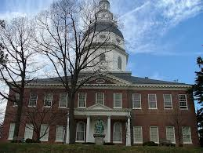
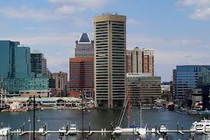
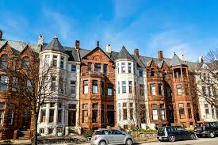
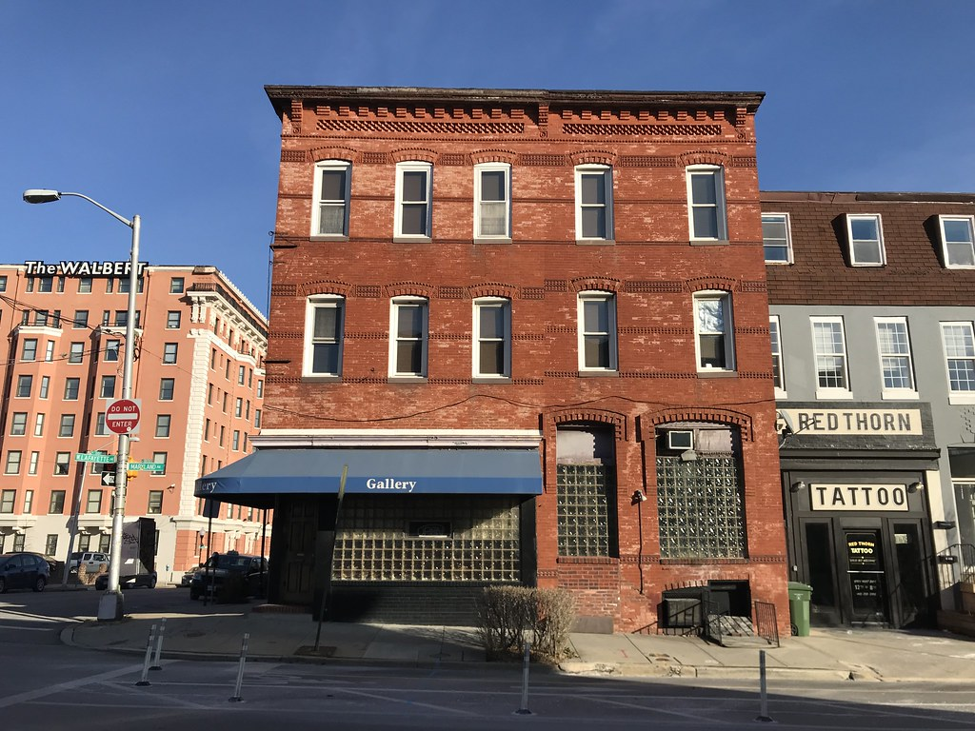
End of Module I
Summary

Slide 75
Building Optimization Benefits
Your work on optimizing your building can:
Increase productivity of building occupants.
Maintain healthy indoor environments.
Improve reliability of major equipment.
Support facility sustainability goals.
You can take an active role in influencing the long-term performance characteristics of your buildings.
Notes:
As you work on optimizing your building, your efforts will contribute to a number of benefits, help your organization meet its targets, and can even benefit yourself (a more comfortable work environment, less frequent/urgent work requests, etc.).
Some of these you can measure quantitatively such as energy, water, and O&M costs. Others are more difficult to measure, such as increases in health, comfort, and productivity.
By taking an active role in optimizing your building, you will be able to track the numerical benefits, or metrics, and have the familiarity and knowledge to account for those harder to measure.

Slide 76
Why should you care?
You feel pressured to lower operating expenses and deliver better results & greater value
You are being compelled to respond to the need for sustainable facilities
You have much more influence over a facility’s effect on the environment & the people in the buildings than those who designed/built them
Notes:
Familiarity with the locations and day-to-day operations of the building systems and occupants puts you at an advantage when optimizing buildings’ energy use.
You are in the best position to bring about change in the building operations, and sustainability goes hand in hand with your daily tasks.

